Slide 1
INFORMATION SYSTEMS APPLICATIONS
Information Systems in Organizations

Slide 2
Learning Objectives
Understand the concept of an organization.
Identify the main organizational functions.
Explain the role of information systems in organizations.
Identify different levels of management.
Understand how information systems support decision-making.
Explain business processes and their importance.
Relate information systems to organizational goals.
INFORMATION SYSTEMS APPLICATIONS
02

Slide 3
What is an Organization?
An organization is a structured group of people who work together to achieve common goals.
Examples: universities, hospitals, banks, manufacturing companies, and government agencies.
Organizations use resources such as people, money, materials, and information to achieve their objectives.
INFORMATION SYSTEMS APPLICATIONS
03

Slide 4
Organizational Resources
Human Resources: employees and managers.
Financial Resources: money and investments.
Physical Resources: buildings, machines, and equipment.
Information Resources: data, information, and knowledge.
Technological Resources: hardware, software, and networks.
Information systems help organizations manage and use these resources effectively.
INFORMATION SYSTEMS APPLICATIONS
04

Slide 5
Organizational Functional Areas
Marketing: promoting and selling products or services.
Finance: managing financial resources.
Accounting: recording and reporting financial transactions.
Human Resources (HR): managing employees.
Production / Operations: producing goods or delivering services.
Management: planning, organizing, and controlling organizational activities.
INFORMATION SYSTEMS APPLICATIONS
05

Slide 6
Role of Information Systems in Organizations
Collecting and processing organizational data.
Supporting daily business operations.
Improving communication and coordination.
Providing information for decision-making.
Monitoring organizational performance.
Improving efficiency and productivity.
INFORMATION SYSTEMS APPLICATIONS
06

Slide 7
Management Levels in Organizations
Operational Level: responsible for daily activities and routine tasks.
Middle Management Level: monitors departments and translates plans into actions.
Top Management Level: sets the overall direction, goals, and strategies.
Each level has different responsibilities and information requirements.
INFORMATION SYSTEMS APPLICATIONS
07

Slide 8
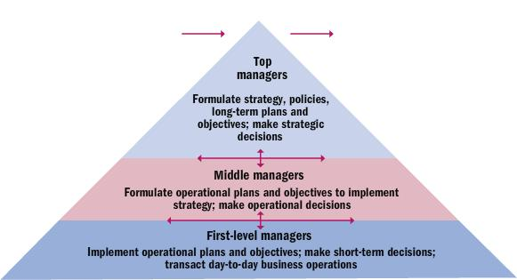
Management Levels in Organizations
08

Slide 9
Operational Management Level
Responsible for daily organizational activities.
Focuses on routine and structured tasks.
Uses detailed and current information.
Examples: processing customer orders, recording sales, managing attendance, and updating inventory.
INFORMATION SYSTEMS APPLICATIONS
09

Slide 10
Middle Management Level
Responsible for monitoring and controlling departmental activities.
Translates organizational plans into departmental actions.
Uses summarized and periodic information.
Examples: monthly sales reports, department budgets, and employee productivity reviews.
INFORMATION SYSTEMS APPLICATIONS
10

Slide 11
Top Management Level
Responsible for the overall direction of the organization.
Establishes long-term goals and strategies.
Makes strategic decisions.
Uses summarized internal and external information.
Examples: entering new markets, opening branches, and major investment decisions.
INFORMATION SYSTEMS APPLICATIONS
11

Slide 12
Information Needs at Different Management Levels
Operational: detailed, current information for routine decisions.
Middle Management: summarized, periodic information for tactical decisions.
Top Management: highly summarized information for strategic decisions.
Information systems provide information according to each management level's needs.
INFORMATION SYSTEMS APPLICATIONS
12

Slide 13
Information Systems and Management Levels
TPS (Transaction Processing System): supports operational activities.
MIS (Management Information System): provides reports for middle management.
DSS (Decision Support System): supports analysis of alternatives and decision-making.
EIS/ESS (Executive Information/Support System): supports strategic information needs of executives.
These systems may complement one another within the same organization.
INFORMATION SYSTEMS APPLICATIONS
13

Slide 14
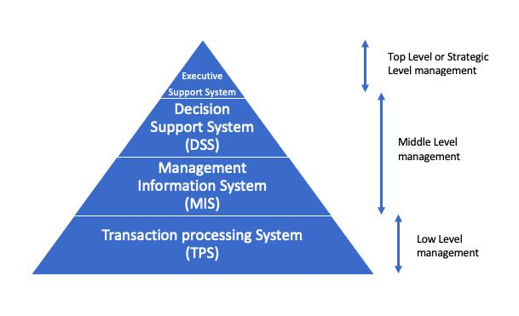
Information Systems and Management Levels
INFORMATION SYSTEMS APPLICATIONS
14

Slide 15
Business Functions and Information Systems
Marketing: customer and sales information.
Finance: financial planning and analysis.
Accounting: financial records and reports.
Human Resources: employee information management.
Production: production and inventory management.
Management: performance monitoring and reporting.
INFORMATION SYSTEMS APPLICATIONS
15

Slide 16
What is a Business Process?
A business process is a set of related activities performed to achieve a specific organizational goal.
Input: data or resources required.
Activities: tasks performed.
Output: the result produced.
Example: Customer Order → Order Verification → Payment Processing → Product Delivery.
INFORMATION SYSTEMS APPLICATIONS
16

Slide 17
Types of Business Processes
Core Processes: directly create value for customers (e.g., selling products and delivering services).
Support Processes: enable core activities (e.g., human resources and IT support).
Management Processes: plan, monitor, and control organizational activities (e.g., strategic planning).
INFORMATION SYSTEMS APPLICATIONS
17

Slide 18
How Information Systems Support Business Processes
Automate repetitive tasks.
Reduce manual errors.
Improve information sharing.
Connect different departments.
Monitor process performance.
Improve service quality.
Example: Order → Inventory Check → Payment → Delivery.
INFORMATION SYSTEMS APPLICATIONS
18

Slide 19
Cross-Functional Information Systems
A cross-functional information system supports activities across multiple departments.
Information can be shared between departments instead of each working independently.
Example: Customer Order
Sales receives the order.
Inventory checks product availability.
Finance processes payment.
Delivery arranges shipment.
All departments need to coordinate to complete the order.
INFORMATION SYSTEMS APPLICATIONS
19

Slide 20
Information Systems and Competitive Advantage
Information systems can help organizations achieve a Competitive Advantage by:
Reduce operational costs.
Improve product and service quality.
Provide faster customer service.
Support innovation.
Improve organizational efficiency.
Help organizations respond to market changes.
Example: accurate inventory information can help an online retailer process orders efficiently.
INFORMATION SYSTEMS APPLICATIONS
20

Slide 21
Practical Case Study – University Organization
A university wants to improve its academic and administrative activities.
Departments: Student Affairs, Finance, Human Resources, Academic Departments, and Management.
Questions:
1. What information does each department need?
2. How can an information system support these departments?
3. Which activities are operational?
4. Which decisions belong to middle management?
5. What information might the university president need?
INFORMATION SYSTEMS APPLICATIONS
21

Slide 22
Summary
Organizations use different resources to achieve common goals.
Functional areas include Marketing, Finance, Accounting, HR, Production, and Management.
Information systems support organizational activities and decision-making.
Organizations have operational, middle, and top management levels.
Business processes consist of related activities that produce specific outputs.
Cross-functional systems connect departments.
Information systems can improve efficiency and competitive advantage.
Next Lecture: Transaction Processing Systems (TPS).
INFORMATION SYSTEMS APPLICATIONS
22

